Slide 1
Food Prices
CSC 10800: Foundations of Data science

Slide 2
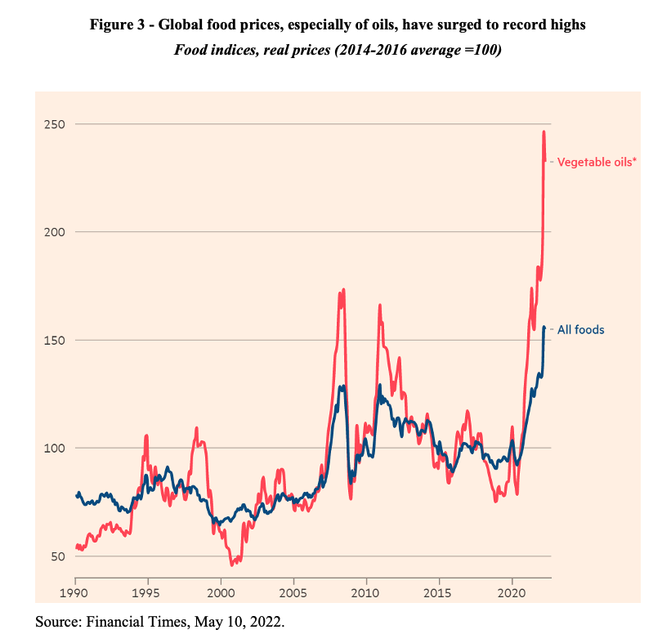
History of Food prices
Throughout many decades it has been claimed that food prices across every region and significantly increased

Slide 3
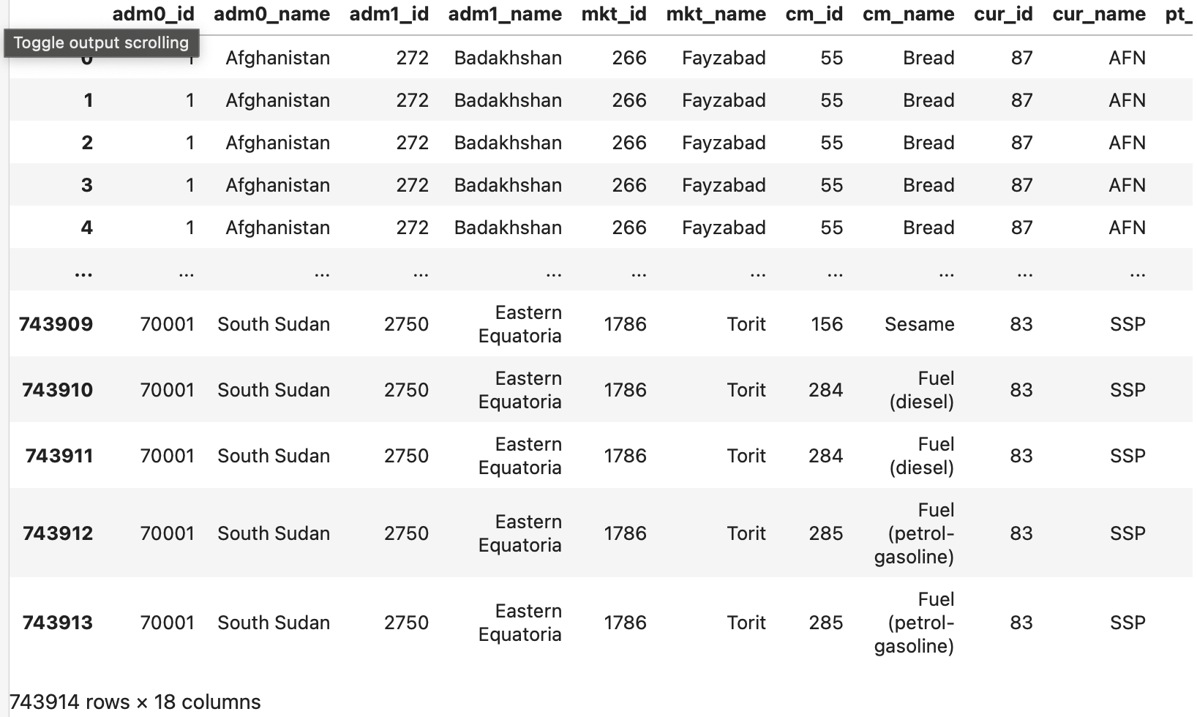
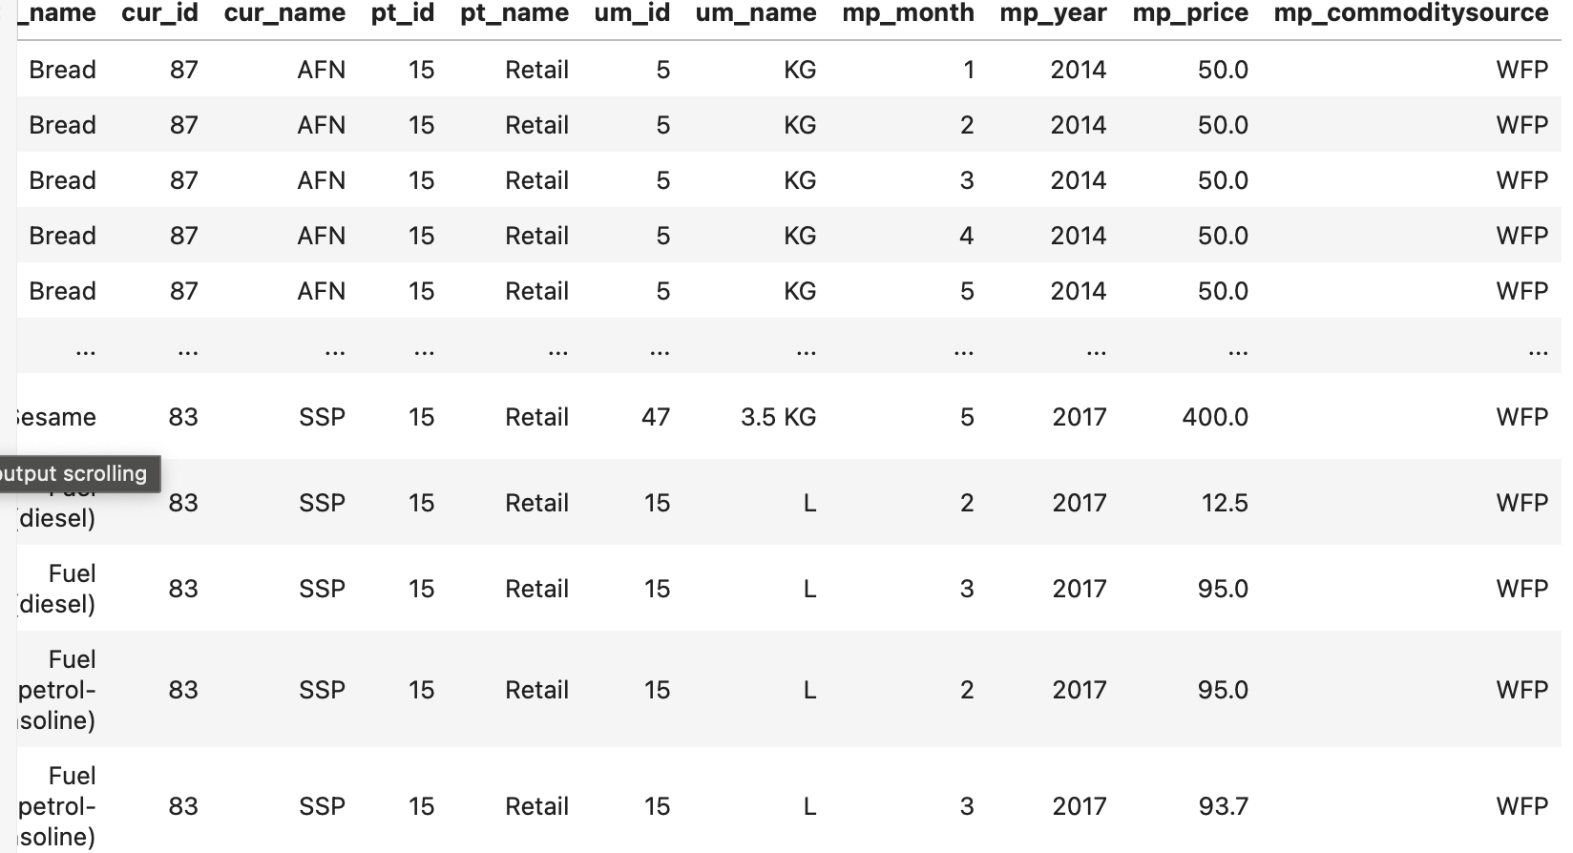
Digitalized
https://www.theglobaleconomy.com/USA/food_price_index_wb/

Slide 4
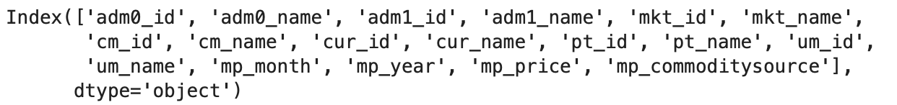
Columns

Slide 5
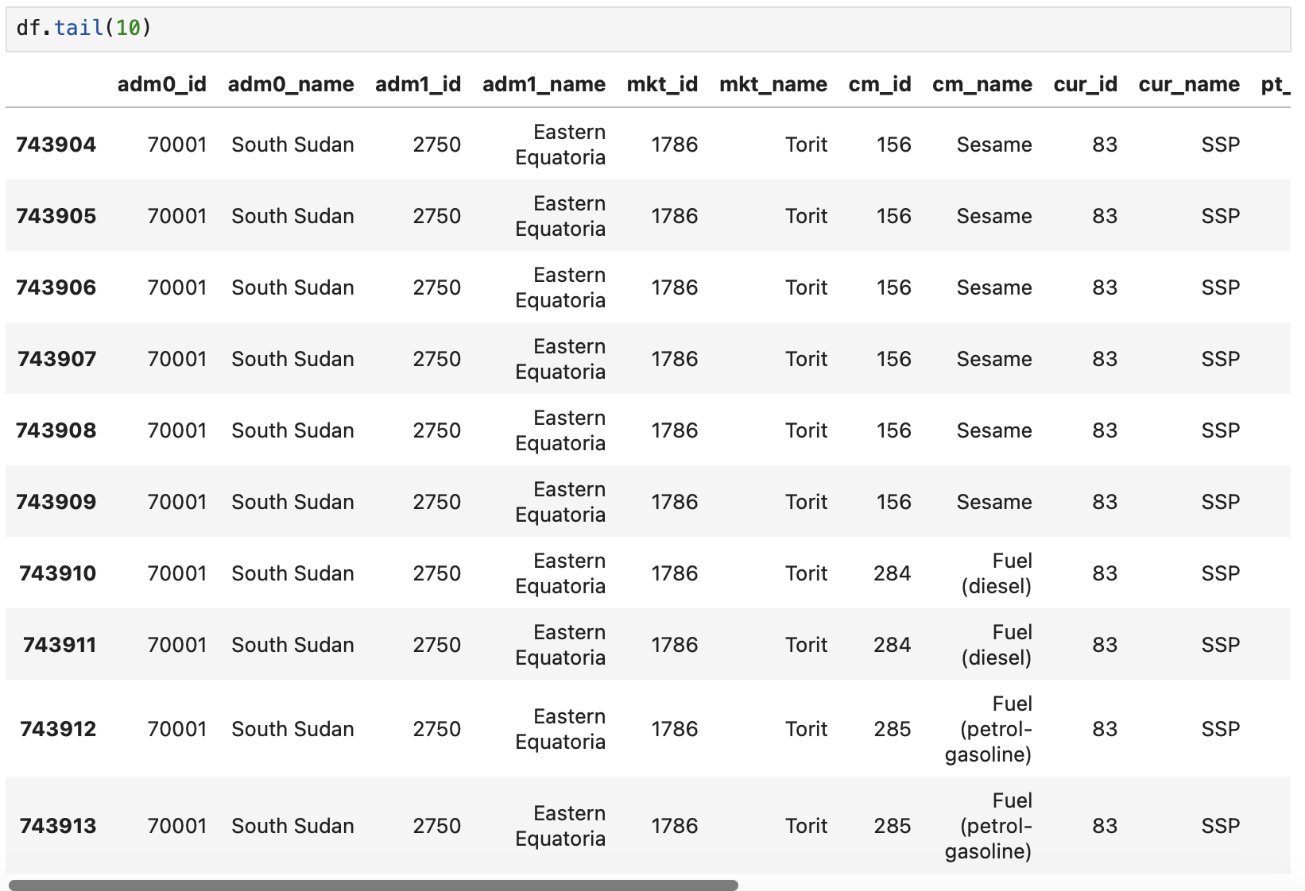
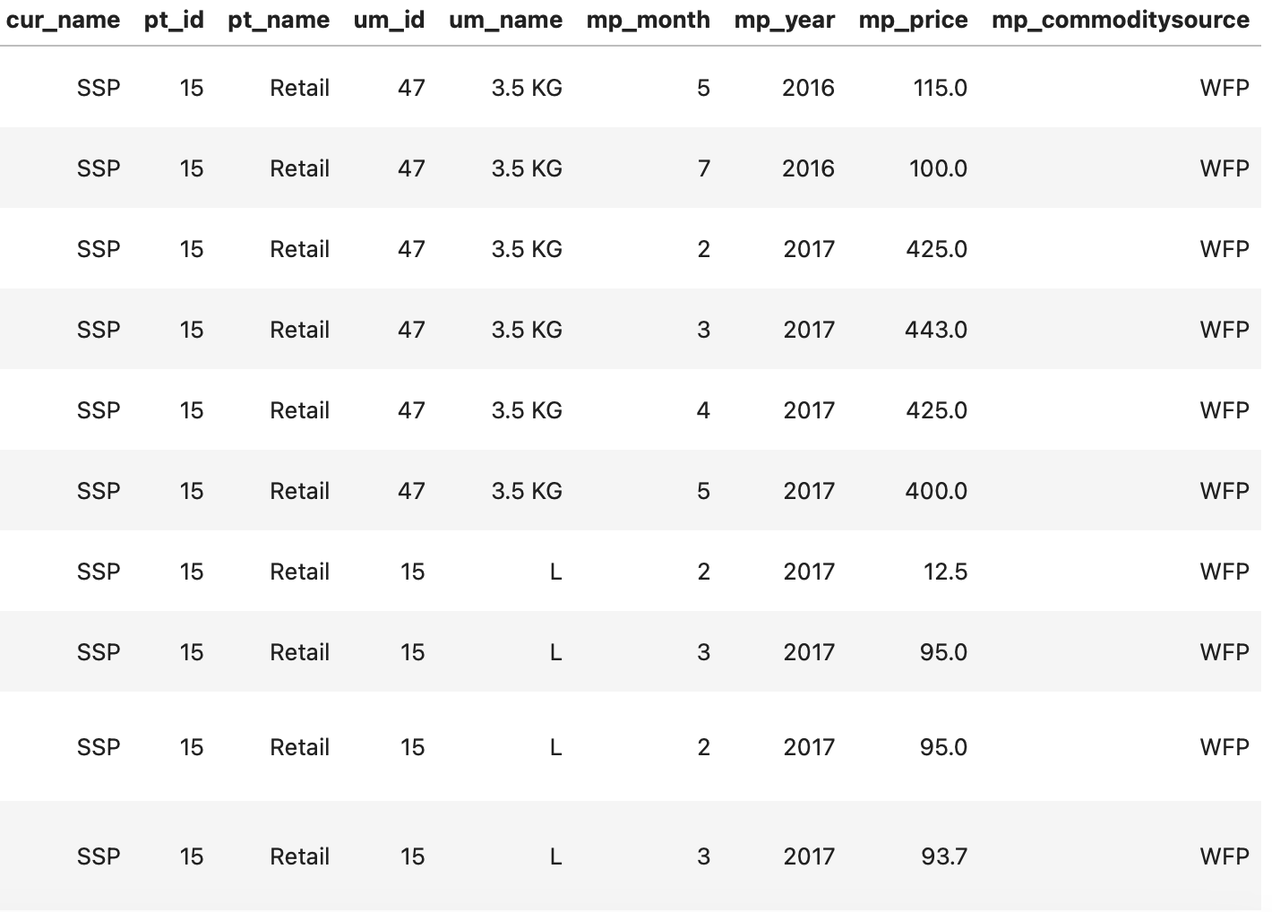
Analyzing data

Slide 6
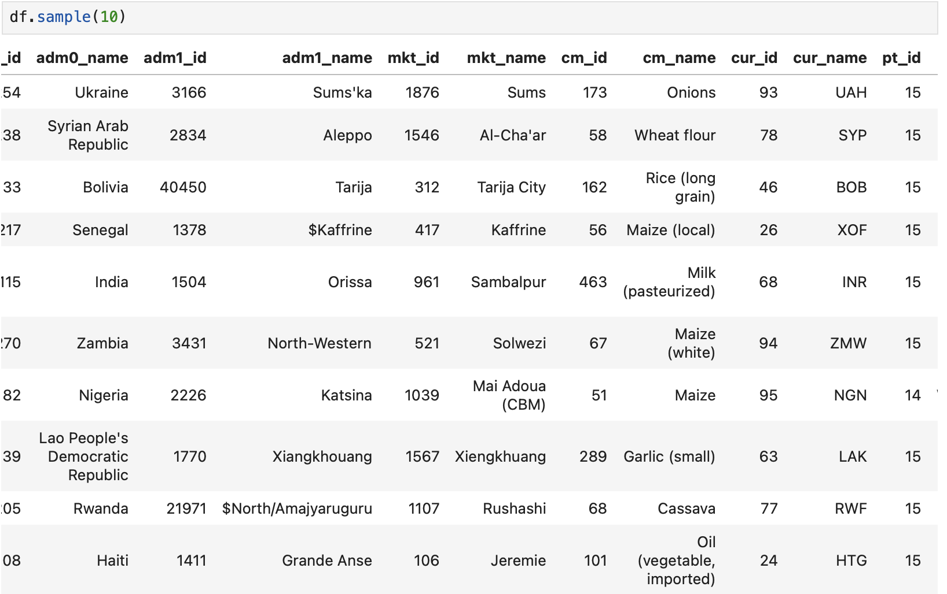
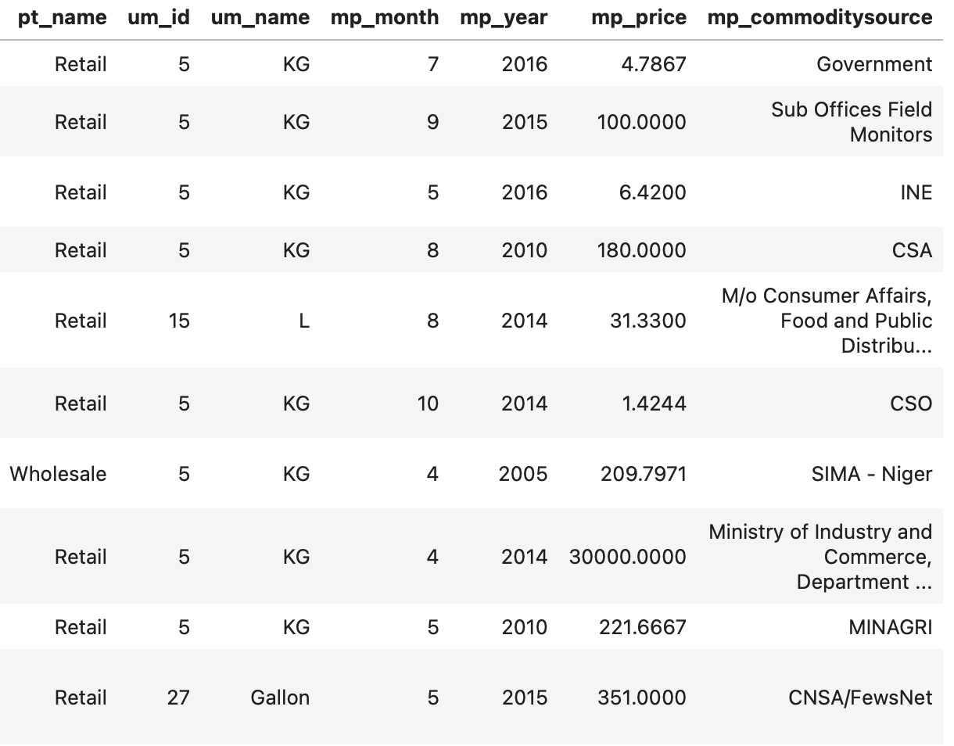
Analyzing data

Slide 7
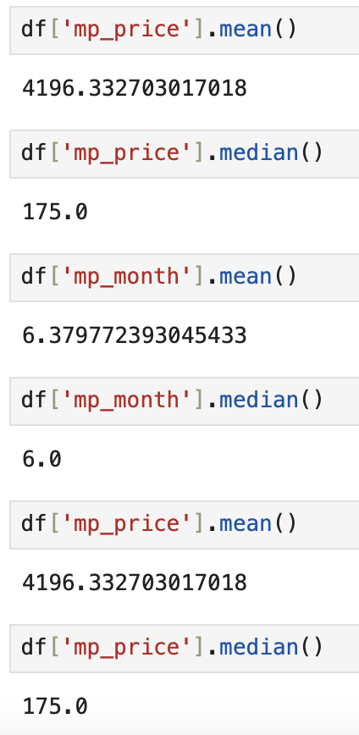
Global prices through the years

Slide 8
Conclusion
Food prices of certain regions would increase yet there are some regions where the price of some foods wouldn’t have much of a change

Slide 9
References
https://www.theglobaleconomy.com/USA/food_price_index_wb/
https://www.policycenter.ma/publications/global-food-price-shock

